Slide 1
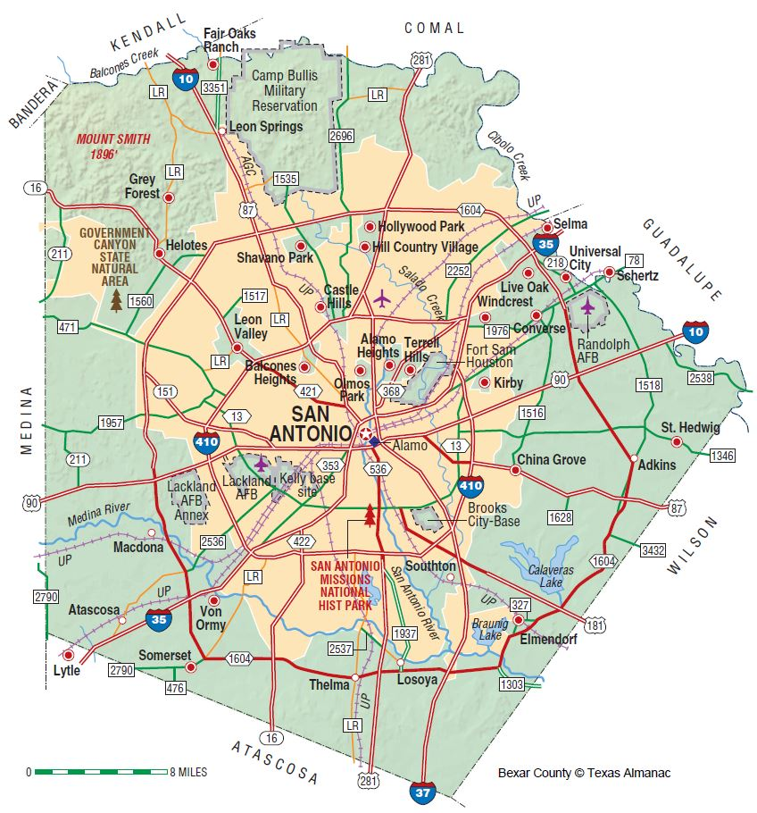
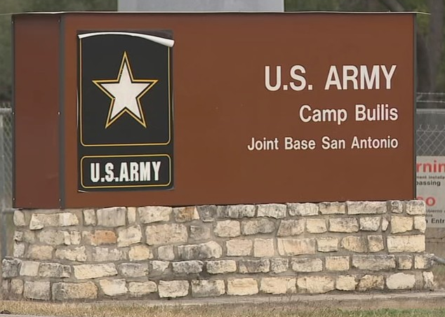


Energy Usage at Camp Bullis, TX
Comparing FY19 to FY20 Usage
Ryan J. Ussery
Resource Efficiency Manager – Contract
802d Civil Engineering Squadron
Certified Energy Manager, Association of Energy Engineers
Accredited Texas Energy Manager, Texas Energy Managers Association
B.S. Agricultural Economics, Texas A&M University
M.S. Management, Troy University
U.S. Army, Retired

Slide 2



Introduction
This project is part of the current contract between Amaze Technology and Joint Base San Antonio (JBSA) to provide Resource Efficiency Managers in order to find Energy Savings Opportunities.
Part of finding Energy Savings Opportunities is to calculate how much energy is being used and compare it to previous usage to establish a baseline. The baseline usage is then used to compare future usage against to track usage and identify facilities or areas where there are significant differences between months in different years.
Camp Bullis was chosen to establish an initial baseline due to the least number of energy accounts as a proof of concept. The baseline process for Camp Bullis may be expanded to other facilities with individual metering.
Currently, the Energy Section of the 802d Civil Engineering
Squadron tracks usage at installation level and not at facility level.

Slide 3
Background
Camp Bullis Military Training Reservation is part of JBSA in Texas. It is largely used for field exercise training for U.S. Army Medical Corps trainees and readiness for all branches and service components.
Historically, the Department of Defense did not build in individual meters at the facility level and paid for the commodity at a master meter.
The Department of Defense started to privatize the utility infrastructure at military installations to include water, electricity and natural gas.
City Public Service (CPS Energy) is the municipality owned utility company of the City of San Antonio, Texas. CPS Energy received the Utility Privatization contract for Fort Sam Houston and Camp Bullis in 2003 through the General Services Administration that included individual meters at facilities.
The rest of JBSA, including Lackland Air Force Base and Randolph Air Force Base, received their Utility Privatization contract with CPS Energy through the Defense Logistics Agency in 2017 that did not include individual meters at facilities.

Slide 4



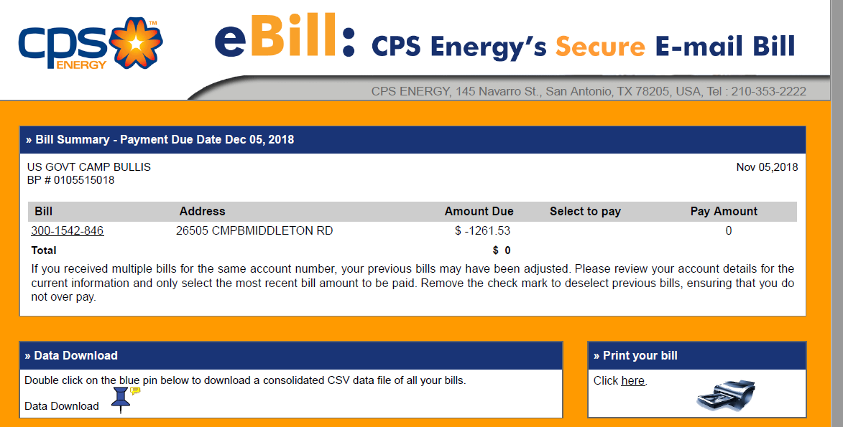
Methods
The data for this presentation was gathered from CPS Energy billing for individual meters on Camp Bullis. CPS Energy sends multiple bills for Fort Sam Houston and Camp Bullis energy usage per month. Camp Bullis energy bills are delivered electronically with between one and five bills to capture the 223 accounts.
FY 19, June
FY 19, October
FY 19, September
The energy bills contain a blue pin feature that allows the billing data to download into Comma Separated Variable files that can be opened with Microsoft Excel.

Slide 5
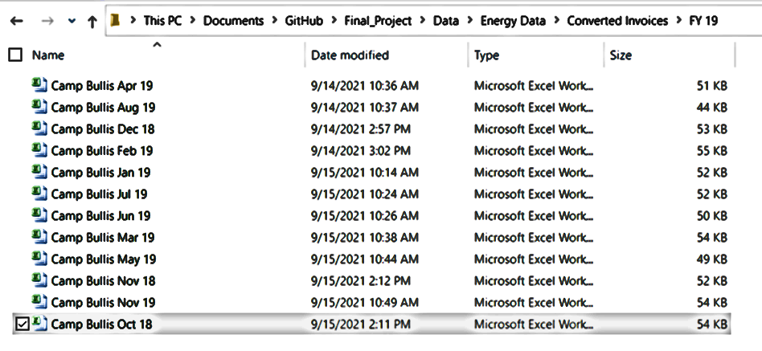
Methods
The multiple bills for one month were consolidated into single files per month for the period of FY19 and FY20. The data set yielded over 10,600 data points to compare facility usage between the same months in FY19 and FY20 by identifying differences in Kilowatt Demand and Kilowatt Hour Usage.
Major differences were graphed and noted for further research through facility, equipment and usage audits. Physical audits may reveal deficiencies in building envelope, equipment inefficiency in operation or settings, and changes in facility usage or user behaviors.

Slide 6
Results

Slide 7
Summary

Slide 8
Conclusions

Slide 9
Questions
?

